Slide 1

RUNGTA COLLEGE OF DENTAL SCIENCES & RESEARCH
GROWTH AND DEVELOPMENT
DEPARTMENT OF PEDODONTICS AND PREVENTIVE DENTISTRY

Slide 2
Specific learning Objectives
Core areas | Domain
Introduction Principles of growth Factors influencing growth and deveoplment | Assessment of growth and development. Gross motor development

Slide 3
CATEGORY
MUST TO KNOW
NICE TO KNOW
Growth assessment parameters
DESIRE TO KNOW
Computerized growth forecasting.
Factors affecting growth and development
Differential growth
Growth spurts
Dental age

Slide 4
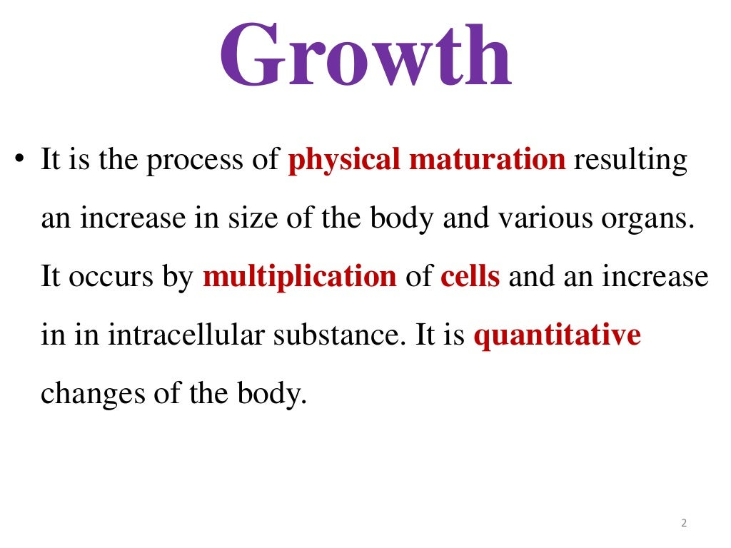

Slide 5
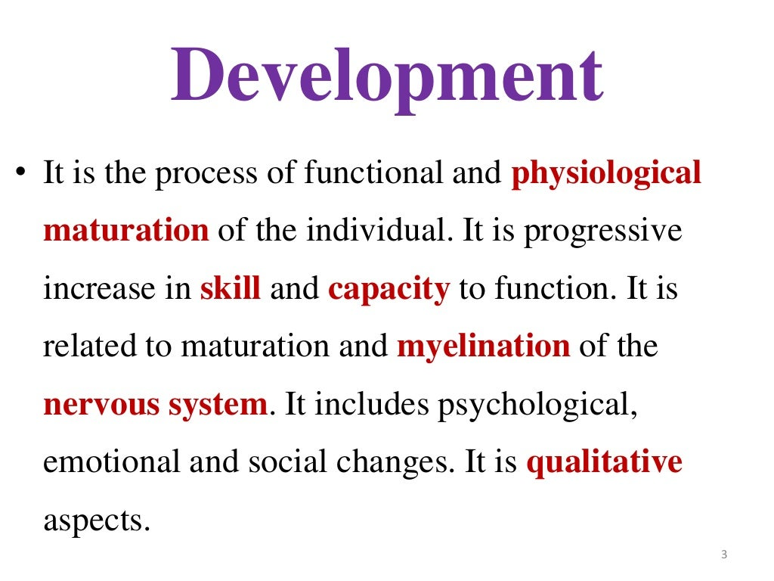

Slide 6
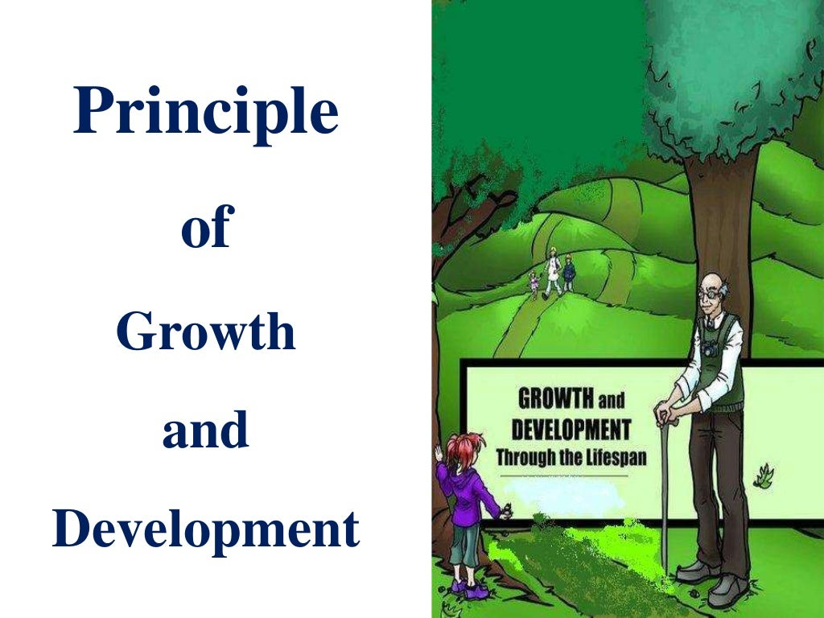

Slide 7
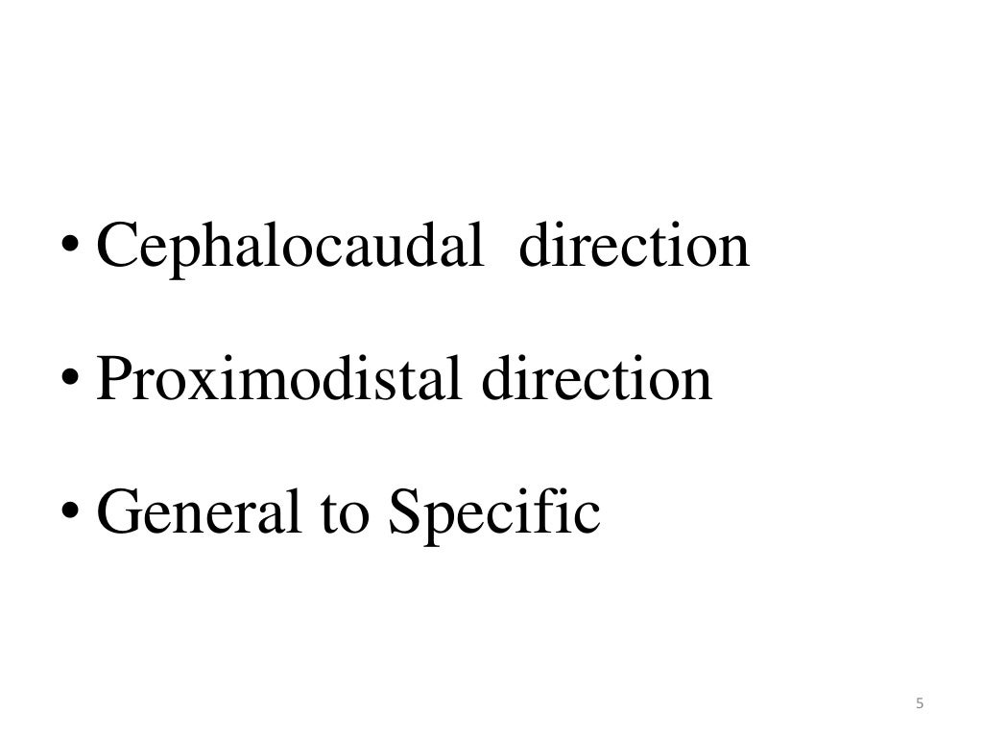

Slide 8
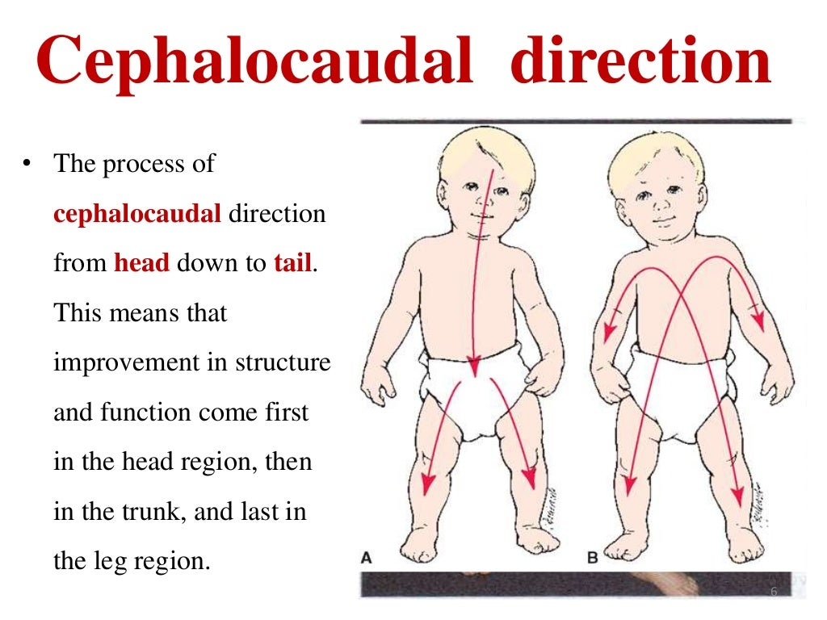

Slide 9
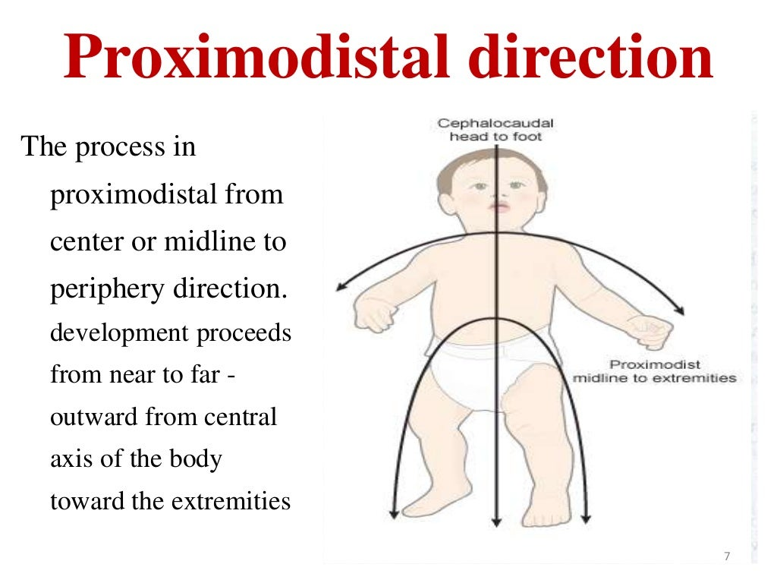

Slide 10
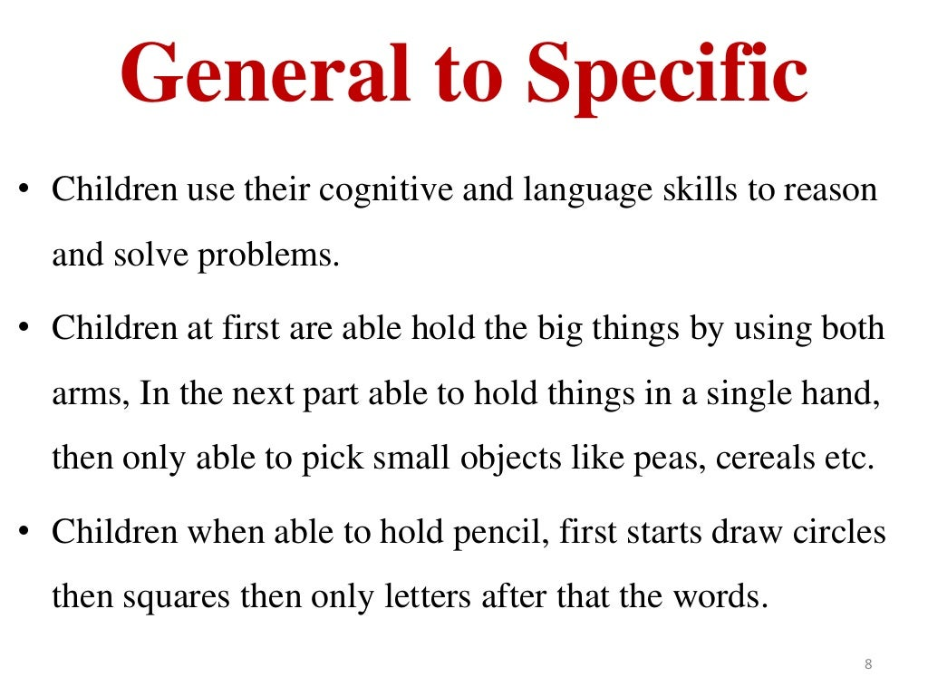

Slide 11
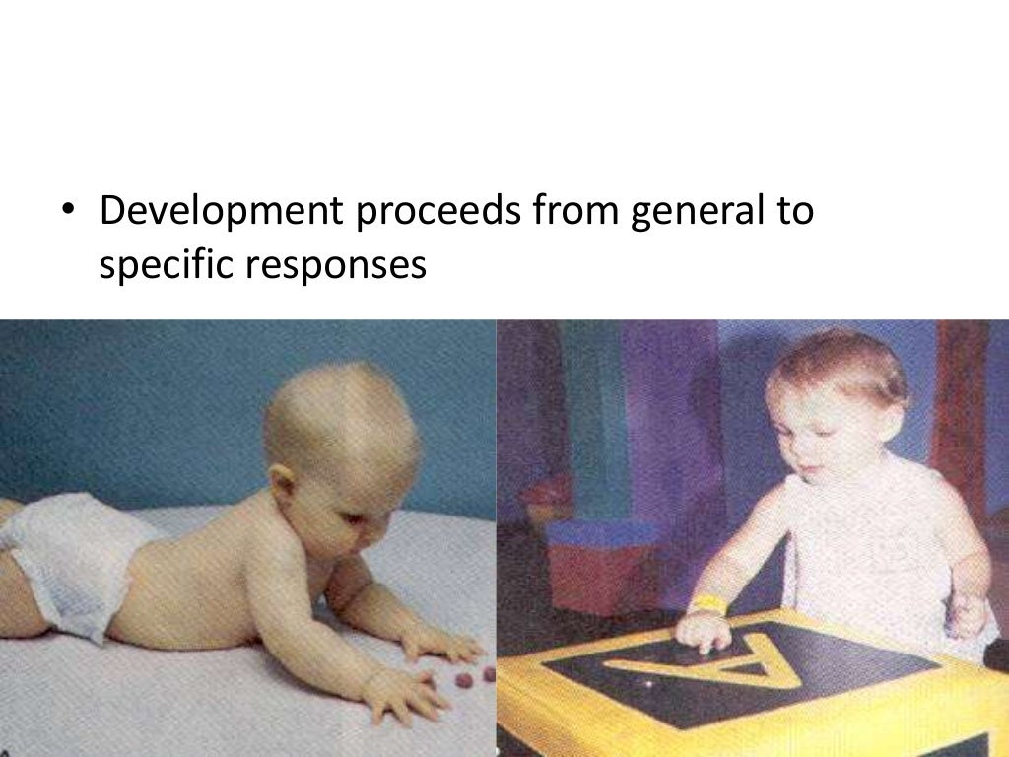

Slide 12


Slide 13
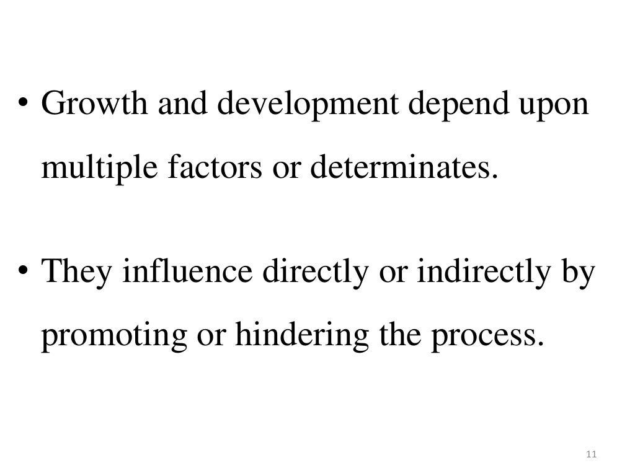

Slide 14
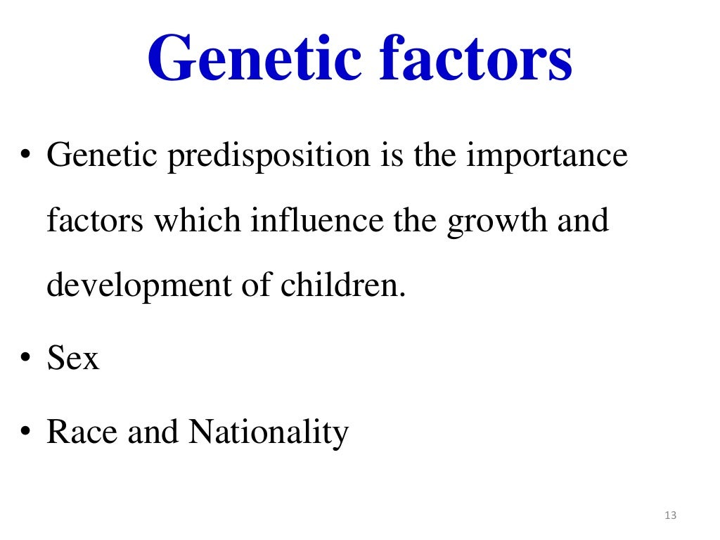

Slide 15
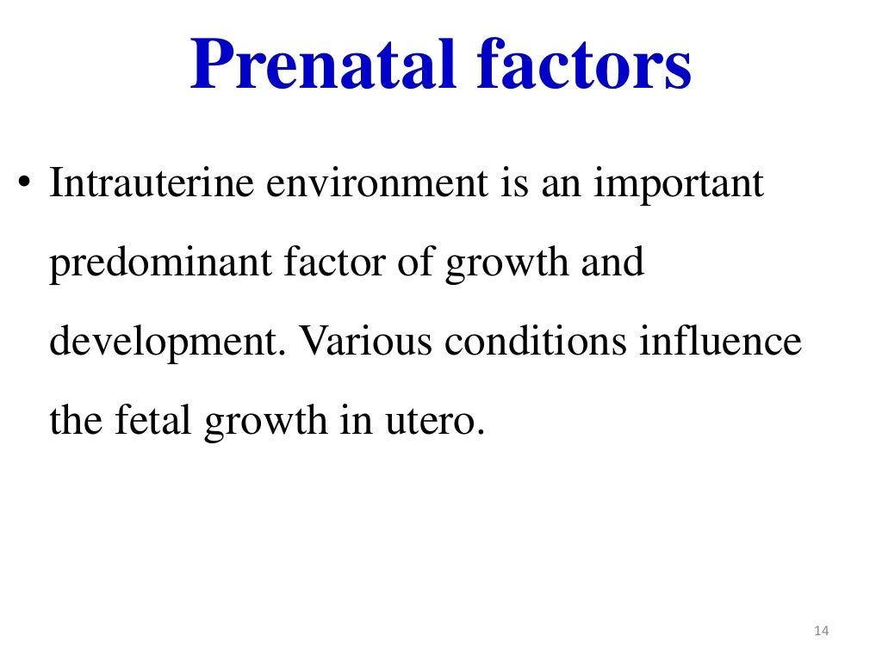

Slide 16
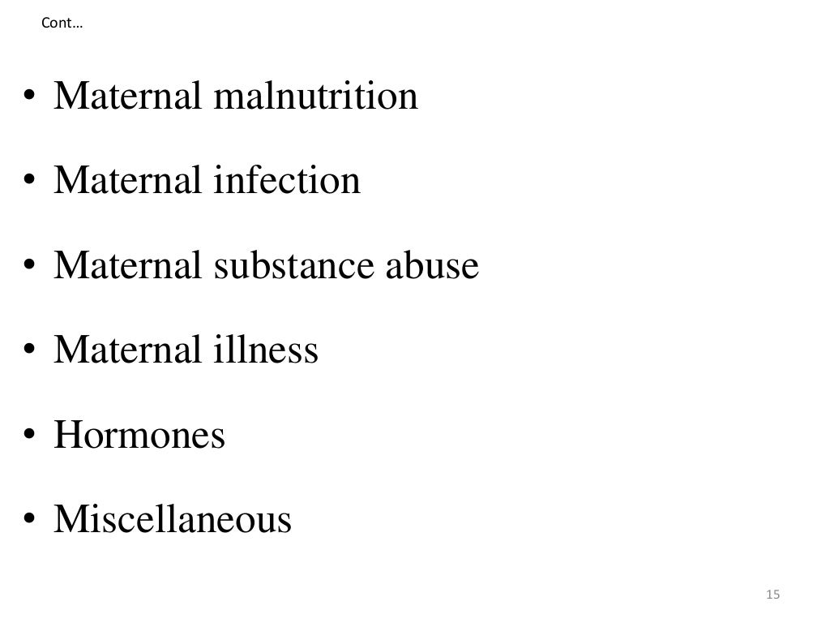

Slide 17
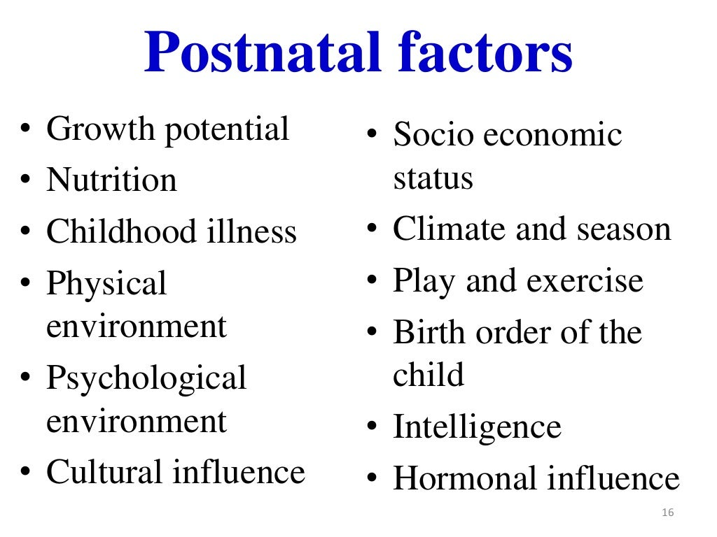

Slide 18
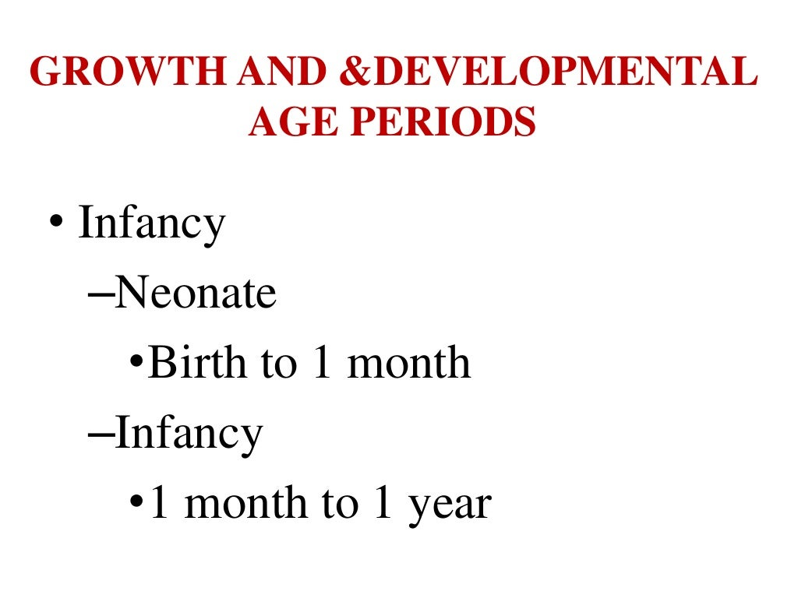

Slide 19
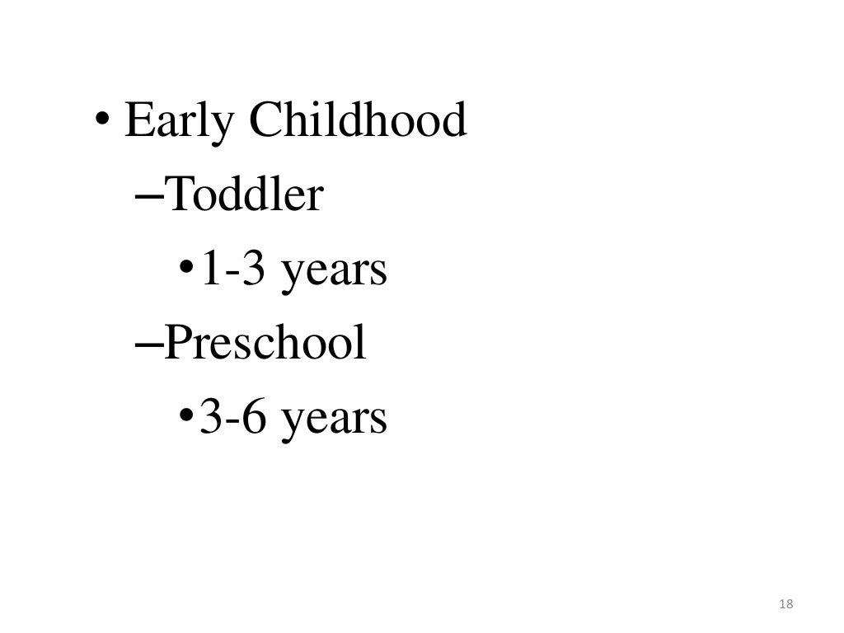

Slide 20
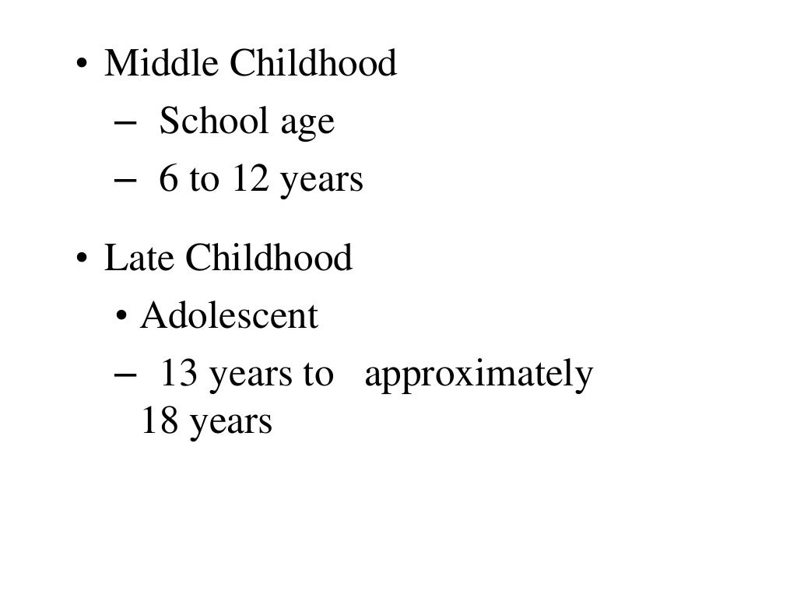

Slide 21
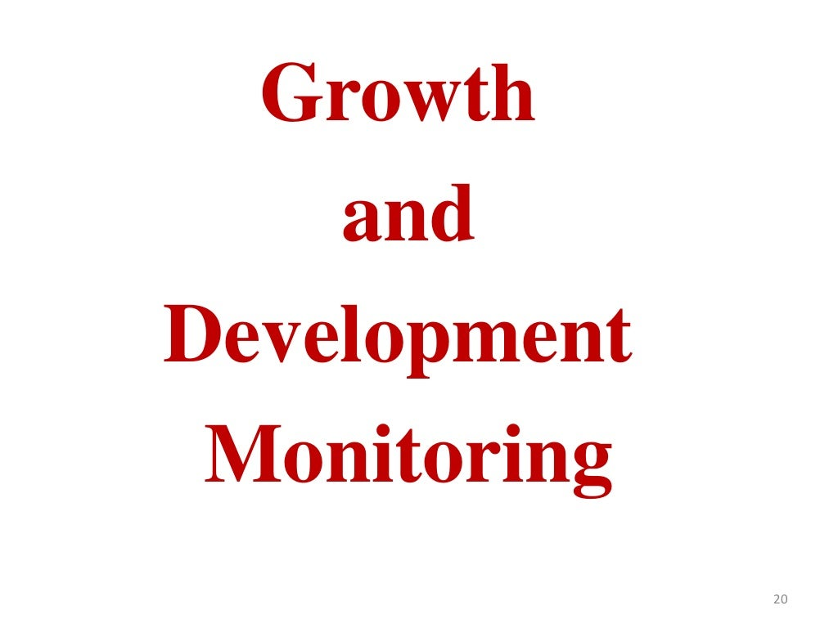

Slide 22
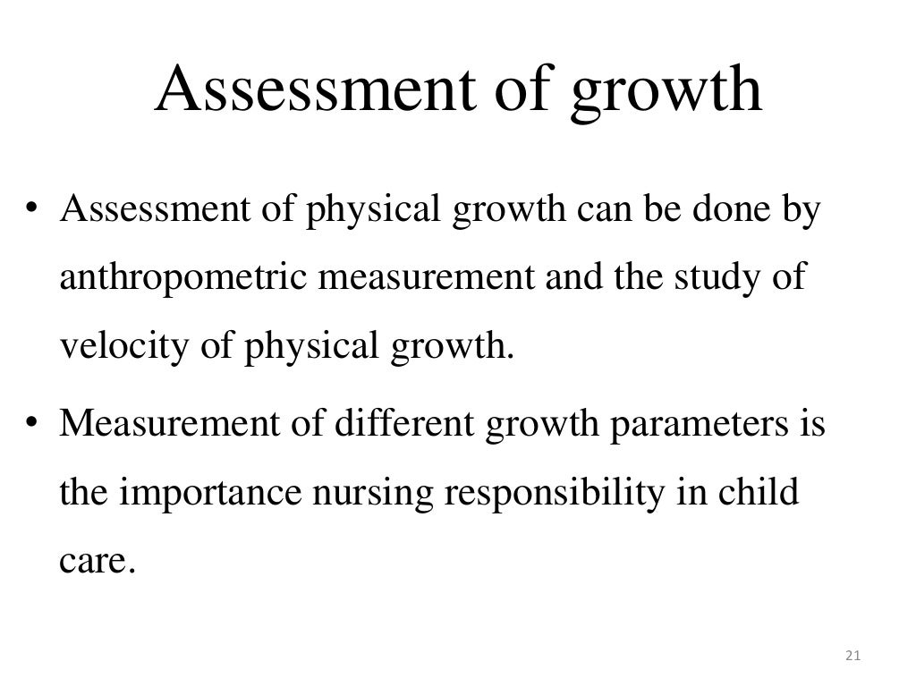

Slide 23
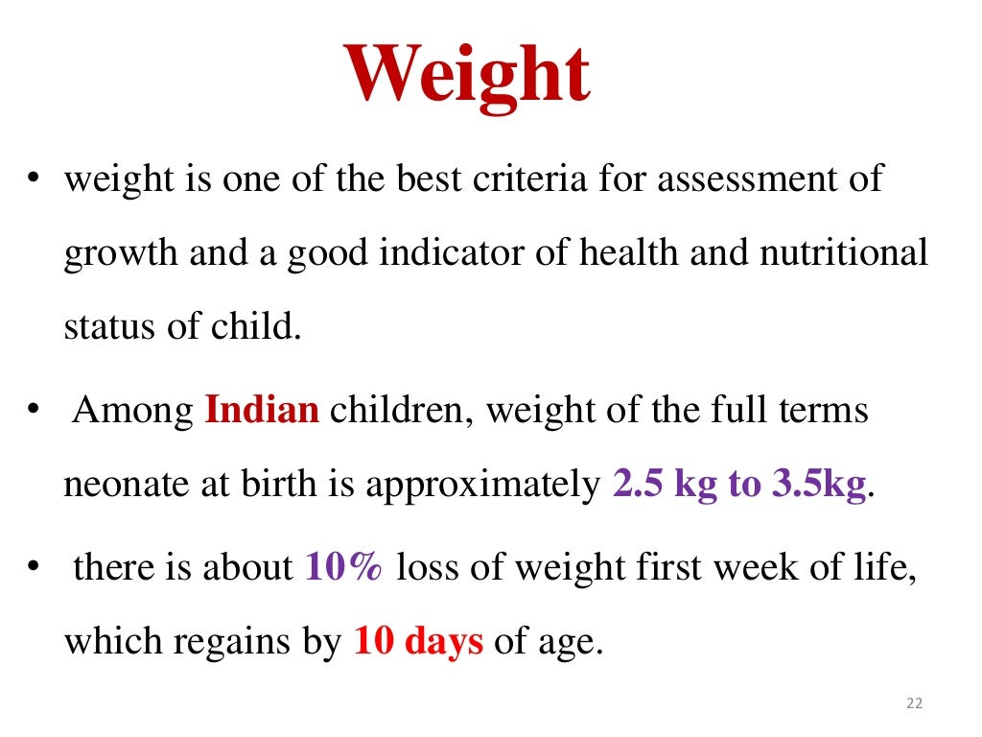

Slide 24
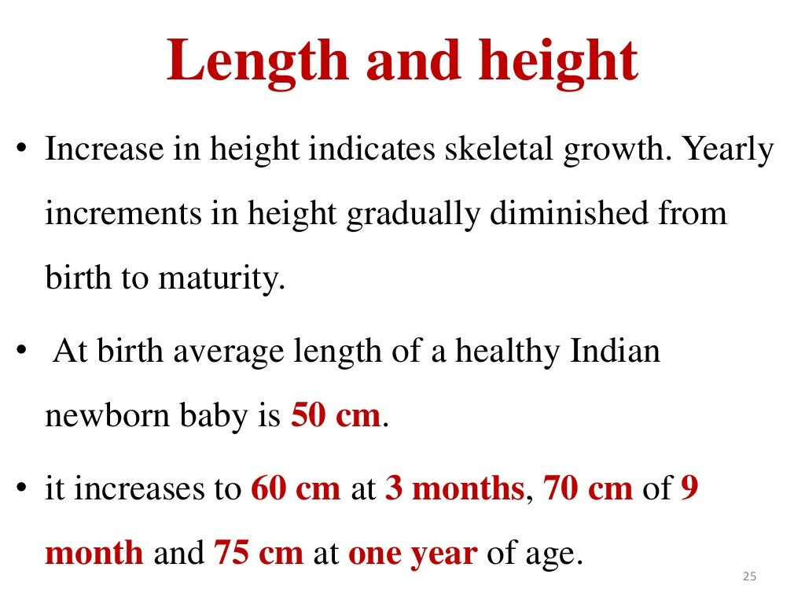

Slide 25
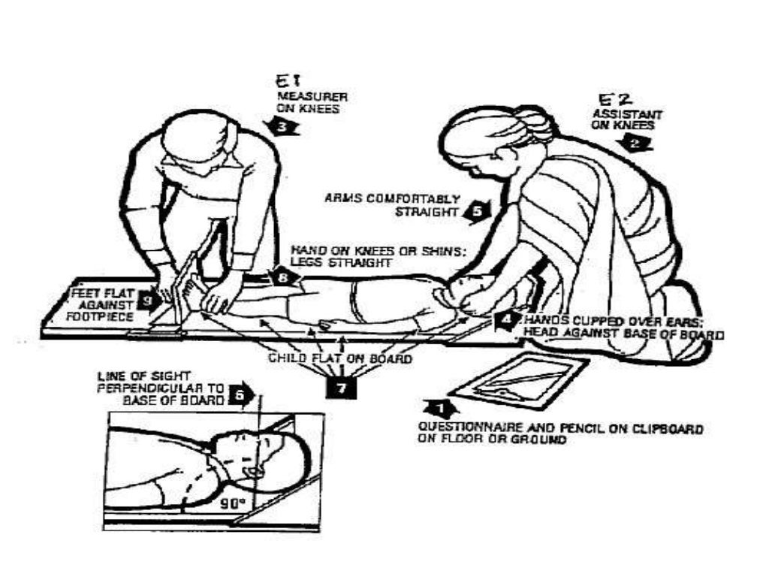

Slide 26
